Slide 1
Variables and Assignment

Slide 2

Let's think about how a real application might use variables
Every program uses variables so we could choose any program
Let's think about Instagram since it's a famous Python web application
Notes:
The web application part of Instagram manages all the data used in the mobile apps too
I don't work for Instagram so I'm making educated guesses about the variables they might use
Instagram is a very complex app so there's more happening that what we'll talk about here - but we are just getting started in programming so we won't worry too much about every detail

Slide 3
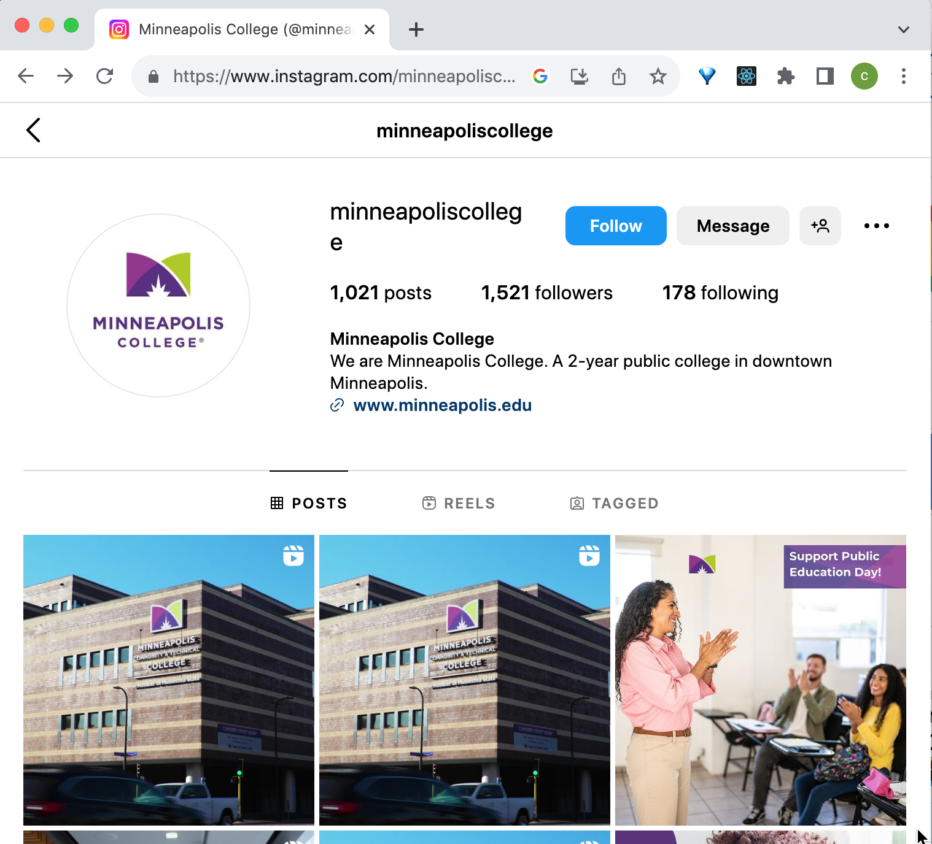
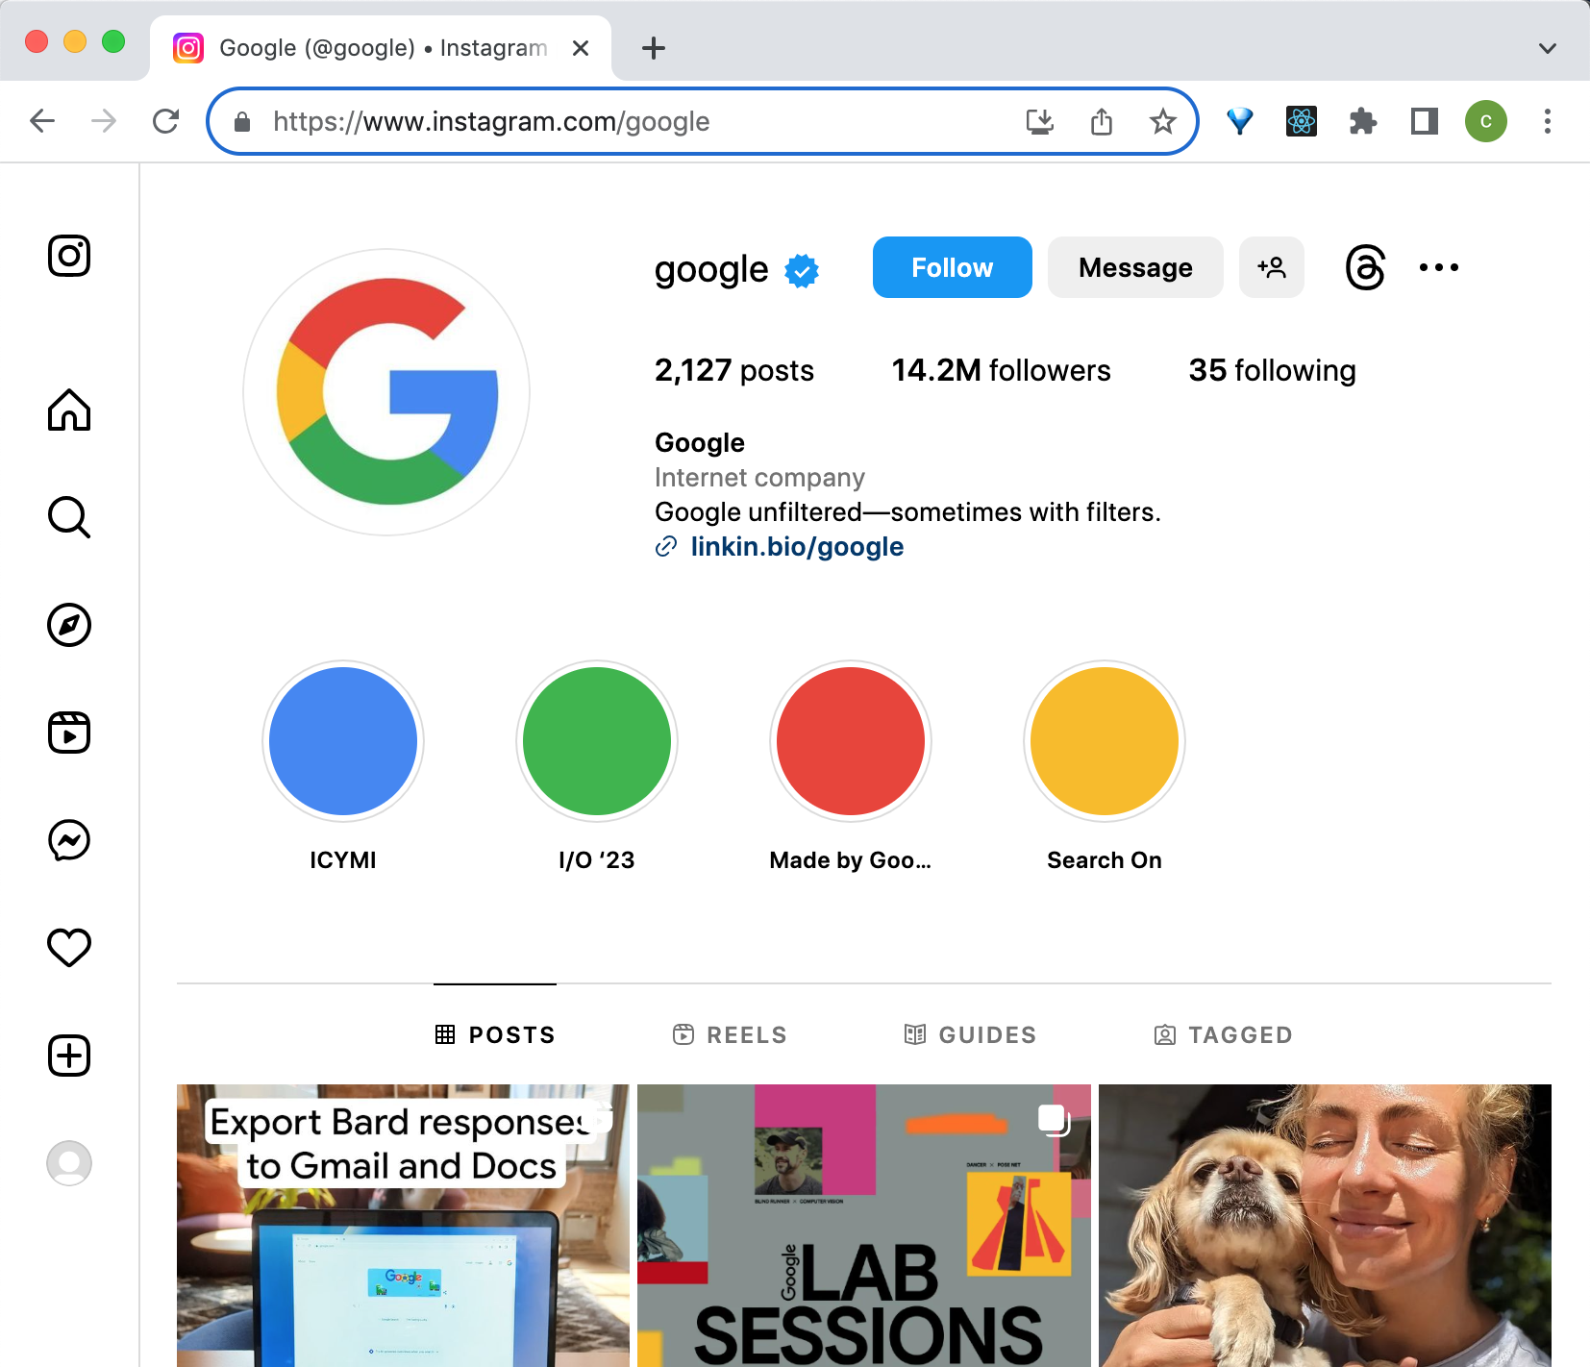
Where are variables used?
What’s the same, and what's different, or could be different, about the @minneapoliscollege and @google pages?

Slide 4
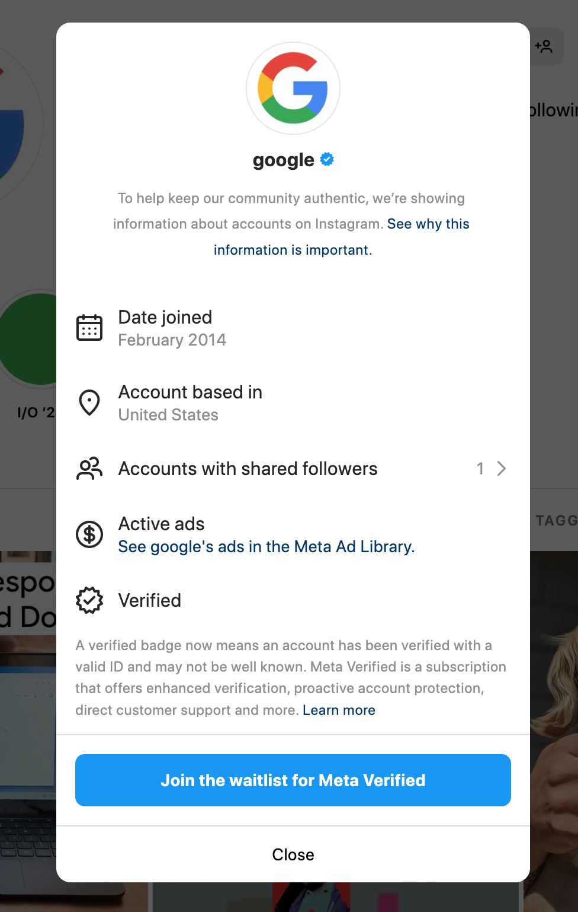
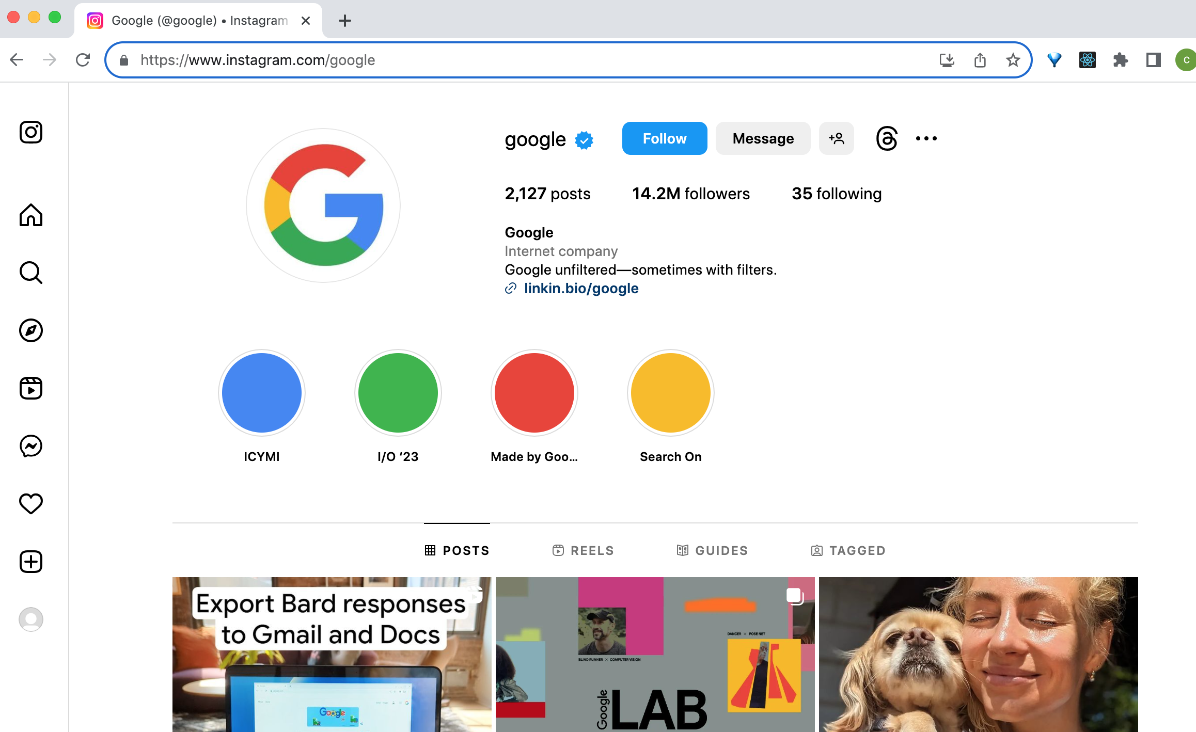
Variables - storing a username, using the variable's data in multiple places

Slide 5
Variables
Different name
Different description
Different number of posts
Different number of followers
Different profile picture - or to be more specific, the link to each profile picture image is different
Different posts -- that's a little more complex, we'll come back to that later - there's a variable storing information about a list of posts
And probably many more

Slide 6

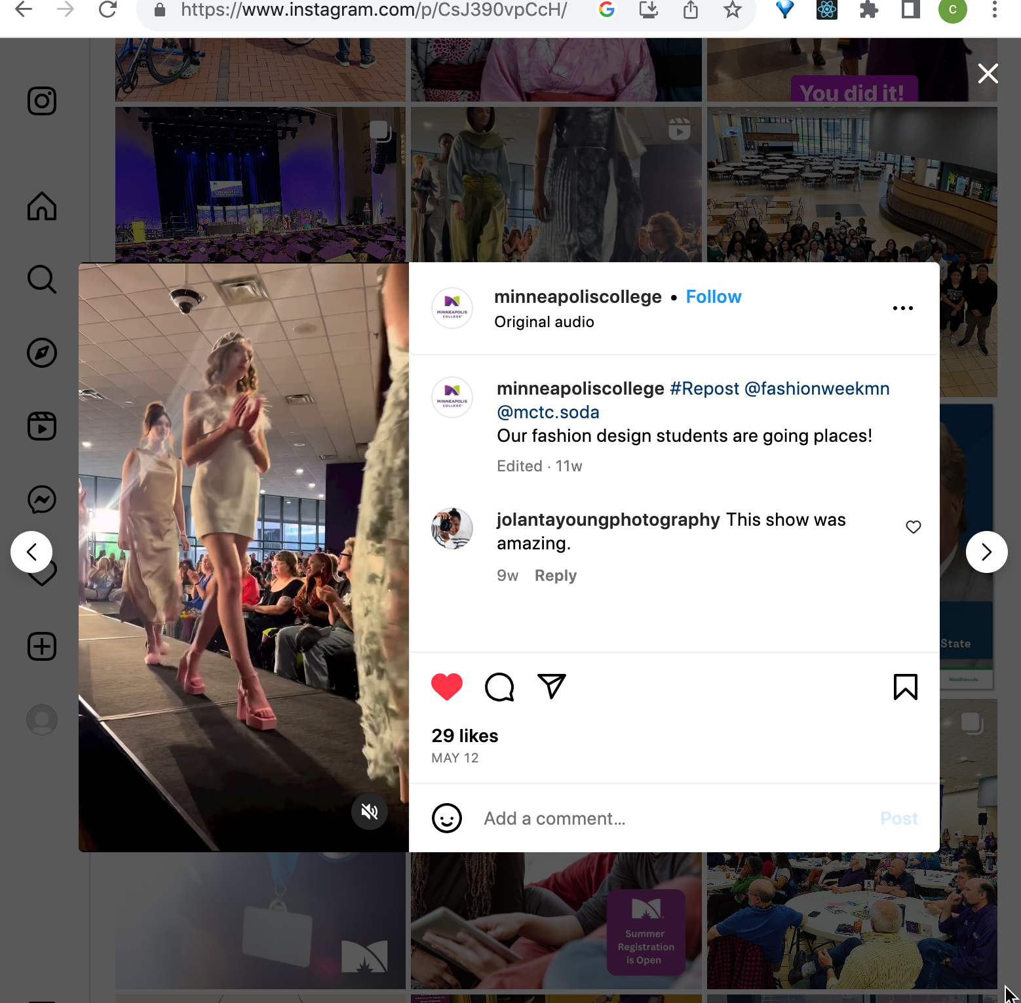

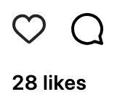
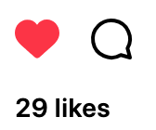
Variables might stay the same, or they can be changed and updated
https://www.instagram.com/p/CsJ390vpCcH/
When you like a post - what happens to the post count?

Slide 7
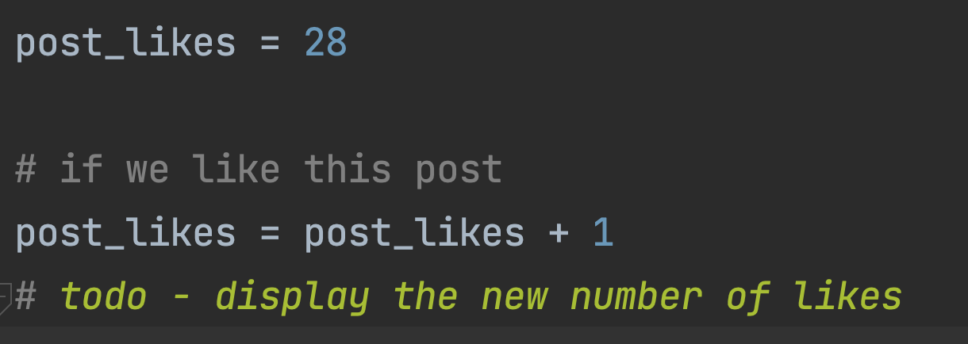
In Python, something like this,

Slide 8
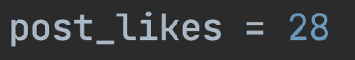
Assignment
Left side of the = is a variable name
Right side of the = is the new value for that variable
Python figures out the value for the right side, then assigns that value to the variable
If the variable doesn't exist, it is created
If the variable does exist, it's value is changed

Slide 9
Assignment
1. Figure out what value this is - the number 28
2. Store the number in this variable
No variable called post_likes exists in the program. So a new variable called post_likes is created
post_likes will be an int (integer number) variable

Slide 10
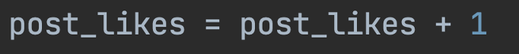
This is assignment too - updating a variable
The right side is post_likes + 1
So, Python needs to look up the current value of post_likes (in this example, 28)
Then add 1
Then store the result, 29, in the post_likes variable
The previous value is overwritten

Slide 11
Assignment
Figure out what value this is
look up what is in post_likes (28)
Add 1
The answer is 29
2. Store 29 in this variable
Now, post_likes does exist, so no new variable is created
The existing post_likes variable is updated. It is still an int

Slide 12
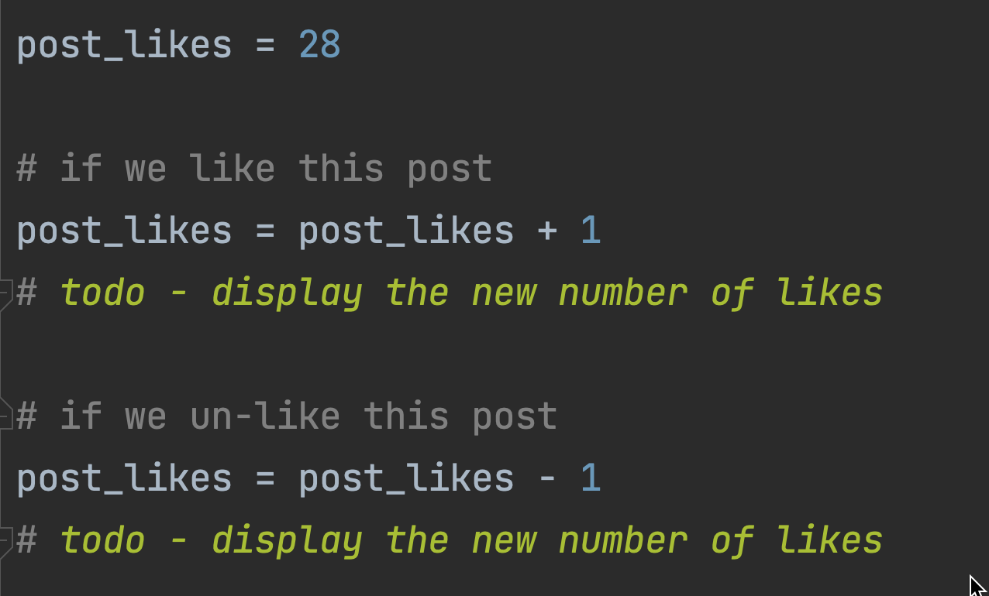
In Python, something like this,
What if I like a post, then I un-like it?
Can you see the new assignment statement?

Slide 13
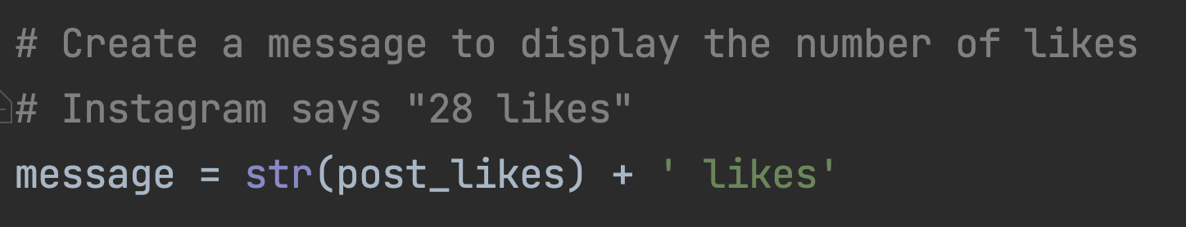
Creating a new variable - the message with the number of likes
What if there are no likes, or 1 like? We'll look at that next week

Slide 14
Assignment
Figure out what value this is
look up what is in post_likes (28)
Convert it to a string '28'
Create a new string ' likes'
Join the '28' and ' likes' strings into a new string
2. Store the result '28 likes' in this variable
message does not exist, so a new str (string) variable is created
The existing post_likes variable not changed, it is still an int

Slide 15
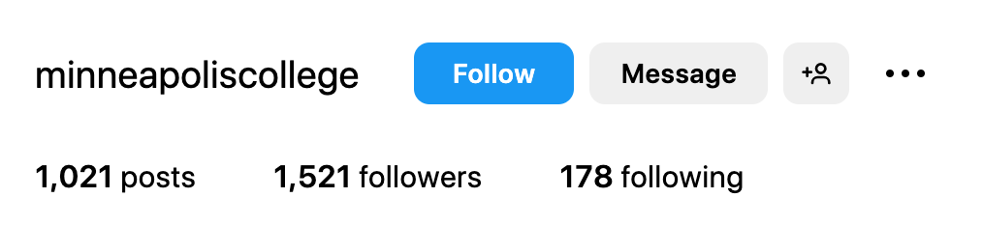
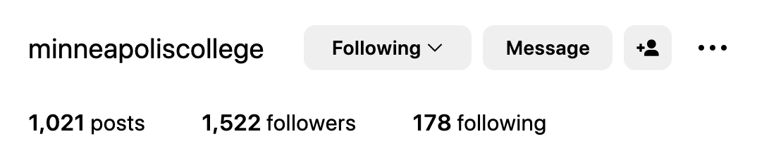
Where else are variables changed?
When someone follows an account, the number of followers changes
The buttons change too based on if I'm following an account or not
We'll look more at that soon

Slide 16
Where else are variables changed?
An account holder can change their username, name, or email
A new post is added - the variable that shows the number of posts will be updated (and the variable with the list of posts will be updated too)

Slide 17
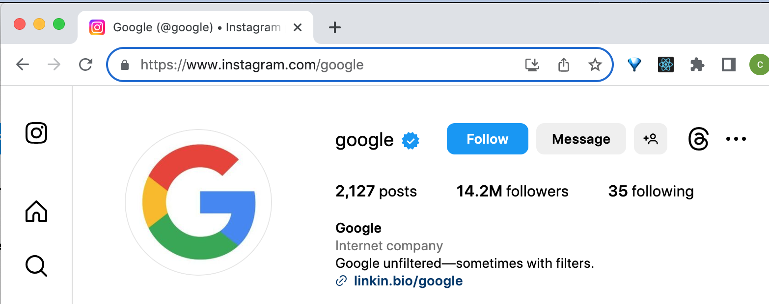
Variables can be used to make new variables
For the google account, look at the page title, it says @google
So, the page title is the account name with "@" in front of it

Slide 18
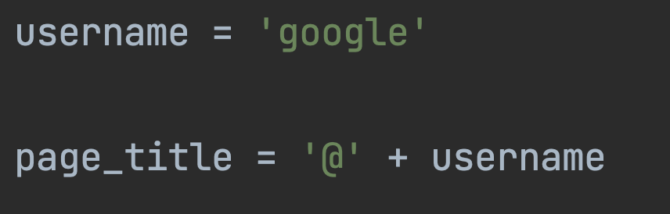
In Python

Slide 19
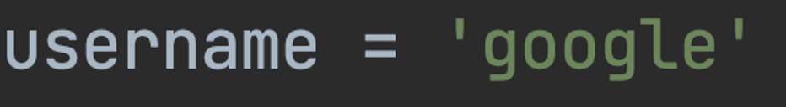
Assignment
Figure out what value this is - create a string 'google'
2. Store the value 'google' in this variable
A variable called username doesn't exist yet, a new variable called username is created and it will be assigned the new value - it will store 'google'
username will be a str (string) variable

Slide 20
Assignment
Figure out what value this is
look up what is in username - the string 'google'
Create a string '@'
Join '@' and 'google'
2. Store the calculated value '@google' in this variable
A variable called page_title doesn't exist yet, a new variable called page_title is created with the assigned value
page_title will be a str (string) variable
username will not be changed

Slide 21
Variable assignment
Variable assignment is used to make new variables and store data in them
Variable assignment is used to update, or change the value stored in a variable that already exists
Variables have types - we've seen str (string), int (integer number) and float (floating point number, a number with a decimal point)
There are others
Programs usually have lots of variables to store the data that the program needs
The data the program works with changes as the program runs and the user interacts with it, so we need to create, change and update variables in our programs

